Slide 1

Single Sign On for ezyVet.com

Slide 2

Beautiful Veterinary Software
Company ezyVet was founded in 2006.
From its humble beginnings of two employees in Auckland to a global veterinary software company with customers in thirty countries, and over 100 employees in offices in Auckland, London, and Dallas.
Initial business development vehicle included invaluable input from a Veterinary Specialist as a partner so the core clinical aspects of ezyVet have been developed by Vets for Vets.
ezyVet was created using open source technologies.
ezyVet uses a great composition of technology which is improving all the time as the Open Source world eco-system pushes forward.
ezyVet uses bank level security and operates on the global hosting environment provided by Amazon in their AWS cloud.
Notes:
ezyVet was founded in 2006 out of the desire for an intuitive, affordable and customisable software that could cater to Veterinary Practices of all sizes and compositions. Plenty of other software options existed but none seemed to tick all the right boxes. Packages either lacked in feature set or were too confusing to implement successfully into everyday practice. The high cost of the available Veterinary Practice Management (VPM) packages were yet another headache, which made it financially out of reach for a large portion of clinics.
A powerful cloud based, feature rich, customisable and easy to use VPM solution for Veterinary Practices all around the world.
From its humble beginnings of two employees in Auckland, New Zealand, to a global veterinary software company with customers in thirty countries, and over 100 employees in offices in Auckland, London, and Dallas.
EzyVet is a passionate team comprised of Developers, Consultants and I.T. People who work closely with a range of Veterinarians and are all about building the most beautiful cloud Veterinary Practice Management (VPM) on the market. This mix ensures we have all angles covered when it comes to your business.
Initial business development vehicle included invaluable input from a Veterinary Specialist as a partner so the core clinical aspects of ezyVet have been developed by Vets for Vets.
ezyVet was created using open source technologies. Open source technology is software in which the source code used to create the program is freely available for the public to view, edit, and redistribute. There are no additional licence costs to on charge to customers using this platform, so that keeps prices down.
ezyVet uses a great composition of technology which is improving all the time as the Open Source world eco-system pushes forward.
ezyVet uses bank level security and operates on the global hosting environment provided by Amazon in their AWS cloud.

Slide 3

Project Background
Currently on every clinic/hospital, user credentials are managed per database.
Often people will have duplicated credentials on separate clinic/hospitals.
Recently added a centralised syncing for user credentials, for the large corporate groups to remove this pain of credential management.
Customers are also asking for integration with active directory, particularly corporates.
As ezyVet grows, tight security is essential. Need a system that is purpose built to handle authentication using best practices.
ezyVet is currently developing other systems. Centralising authentication would make credential management easier.
Notes:
Project has been promised but often on the backburner as more urgent projects take priority. But by not taking this step, Company has forgone a lot of benefits for itself and its users.
Currently on every clinic/hospital, user credentials are managed per database.
Often people will have duplicated credentials on separate clinic/hospitals.
Recently added a centralised syncing for user credentials, for the large corporate groups to remove this pain of credential management.
Customers are also asking for integration with active directory, particularly corporates.
As ezyVet grows, tight security is essential. Need a system that is purpose built to handle authentication using best practices.
ezyVet is currently developing other systems. Centralising authentication would make credential management easier.

Slide 4
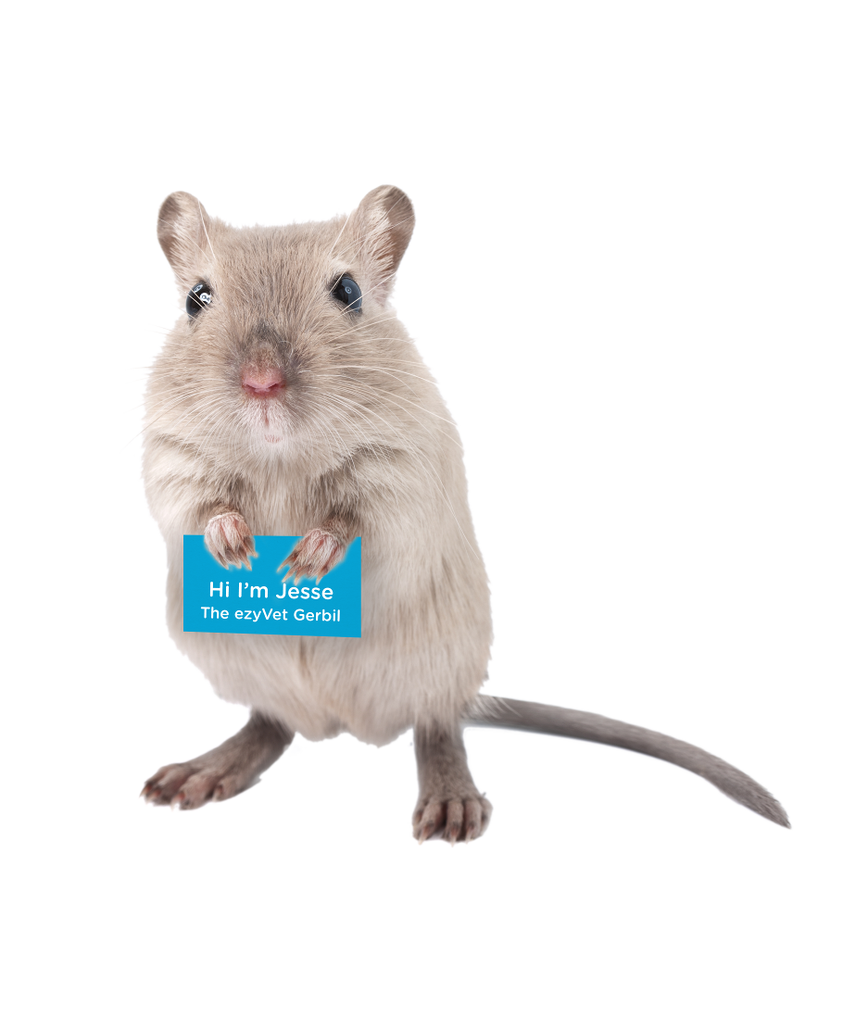
Project goals
Really need to centralise authentication.
Permissions should still be managed per database.
But it would be a lot better if managed user credentials be separated from core system.
This will also encompass a migration process of existing users to the identity management provider.
From preliminary research SAML authentication will be provided using SimpleSAMLphp for the identity provider.
Notes:
Software really needs to centralise authentication, permissions should still be managed per database, but it would be a lot better if user credentials management separated from all core system.
This will also encompass a migration process of existing users to the identity management provider.
From internal preliminary research SAML authentication will be provided using SimpleSAMLphp for the identity provider, and all core product.

Slide 5

Project contribution
• Users on multiple locations could be given/revoked access easily.
• Resetting a password would not need to be done in multiple locations.
• Developers would be able to concentrate their efforts on security. If users only need to login once , they will be more inclined to use two factor authentication.
• Moving databases means they will not be transferring user credentials, while obviously encrypted well, it would be better if Company could greatly limit access to this data.
• Integrating with other identity management providers. Many corporate groups use active directory for example. But there are many other only services that could be used.
• Having other identity providers integrated will mean in some cases Company would not be managing user credentials at all.
• Developers are also adding other applications that will work with core system API, as well as other separate systems. Decoupling authentication from core system should simplify authentication for those systems and allow to do more.
Notes:
Users on multiple locations could be given/revoked access easily.
Resetting a password would not need to be done in multiple locations.
• Developers would be able to concentrate their efforts on security. If users only need to login once , they will be more inclined to use two factor authentication.
• Moving databases means they will not be transferring user credentials, while obviously encrypted well, it would be better if Company could greatly limit access to this data.
• Integrating with other identity management providers. Many corporate groups use active directory for example. But there are many other only services that could be used.
• Having other identity providers integrated will mean in some cases Company would not be managing user credentials at all.
• Developers are also adding other applications that will work with our core system API, as well as other separate systems. Decoupling authentication from our core system should simplify authentication for those systems and allow us to do more.

Slide 6

Project Milestones Totals
Research | 35 %
Developing testing environment | 50 %
Testing | 10 %
Analyzing results of testing | 5 %
Reflections and Disscussions. Returning to the first stage. | 5 %
Notes:
Research been doing through open sources of information like web. Best practices, internet
discussions, software advertisements, Open Source projects.
Developing testing environment most time consuming part .
It takes knowing wide range of developing and virtualisation tools. Such as like Oracle VirtualBox, Vagrant, Chrome debugging and logging tools, some new technologies and program languages.

Slide 7
Project stages - Initial Research
Single Sign-On (SSO)
Single sign-on (SSO) is an authentication process that allows a user to access multiple applications with one set of login credentials. SSO is a common procedure in enterprises, where a client accesses multiple resources connected to a local area network (LAN).
SAML
Security Assertion Markup Language (SAML, pronounced sam-el) is an open standard for exchanging authentication and authorization data between parties, in particular, between an identity provider and a service provider.
Notes:
as suggested in the project description, it all started with the study of the open source project SimpleSAMLphp and what exactly is the SingleSign-On technology (SSO).
Single sign-on (SSO) is an authentication process that allows a user to access multiple applications with one set of login credentials. SSO is a common procedure in enterprises, where a client accesses multiple resources connected to a local area network (LAN).
Security Assertion Markup Language (SAML, pronounced sam-el) is an open standard for exchanging authentication and authorization data between parties, in particular, between an identity provider and a service provider.

Slide 8
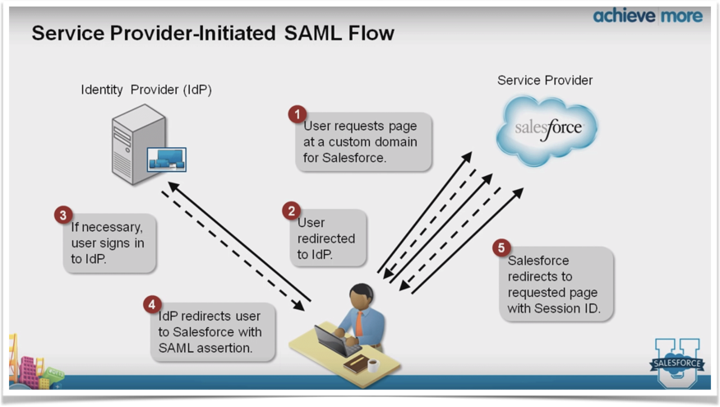
How it works
Information flows between all participants secured by encryption
Notes:
1. User wants to log in into service,
2. Service Provider redirects user to Standalone Identity Provider,
3. User signs in to Identity Provider and if it successful
4. Identity Provider redirects user to the Service Provider with special SAML assertion package which allows user to get requested page with users session ID

Slide 9
Project stages - Getting into working environment
Tools and Software used in project
Oracle VM VirtualBox. VirtualBox is powerful Cross-platform Virtualization Software for x86-based systems. The VirtualBox Extension Pack is available under the VirtualBox Extension Pack Personal Use and Evaluation License, which is a free license for personal, educational or evaluation use.
Vagrant is an open-source software product for building and maintaining portable virtual software development environments, e.g. for VirtualBox, Hyper-V, Docker containers, VMware, and AWS. It tries to simplify software configuration management of virtualizations in order to increase development productivity.
Git is a distributed version control system for tracking changes in source code during software development. It is designed for coordinating work among programmers, but it can be used to track changes in any set of files.
PHP WebStorm
Notes:
VirtualBox is powerful Cross-platform Virtualization Software for x86-based systems. The VirtualBox Extension Pack is available under the VirtualBox Extension Pack Personal Use and Evaluation License, which is a free license for personal, educational or evaluation use,
Vagrant is an open-source software product for building and maintaining portable virtual software development environments, e.g. for VirtualBox, Hyper-V, Docker containers, VMware, and AWS. It tries to simplify software configuration management of virtualizations in order to increase development productivity.
Git is a distributed version control system for tracking changes in source code during software development. It is designed for coordinating work among programmers, but it can be used to track changes in any set of files.
PHP WebStorm

Slide 10

Personal Challenges and Overcomes
Lack of knowledges in this field
Lack of experience and skill
Notes:
I think everyone stepping into new area feel a lack of knowledge and experience there
as for me I have not heard about such software like Vagrant I have not ever developed provisioning scripts which create virtual environment for development process in one-click.
That is why I had to sit some online courses to fill this gaps.

Slide 11
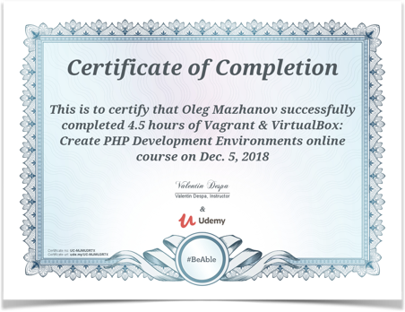
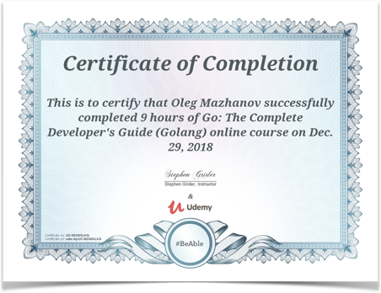
Personal learning curves
I gained a lot of knowledge from daily communication, discussions and exchange of thoughts with the head of my project Bennet Thompson.
I have taken online courses in Udemy Academia.
Some knowledge I gain discovering internet sources.
Notes:
I gained a lot of knowledge from daily communication, discussions and exchange of thoughts with the head of my project Bennet Thompson.
Also I took an online courses at Udemi Academy. One of them was “Vagrant & VirtualBox: Creating PHP Development Environment”, and the second was “Full Online Developer Guide Course (GoLang)”
Some knowledge I gain by discovering Internet sources.

Slide 12
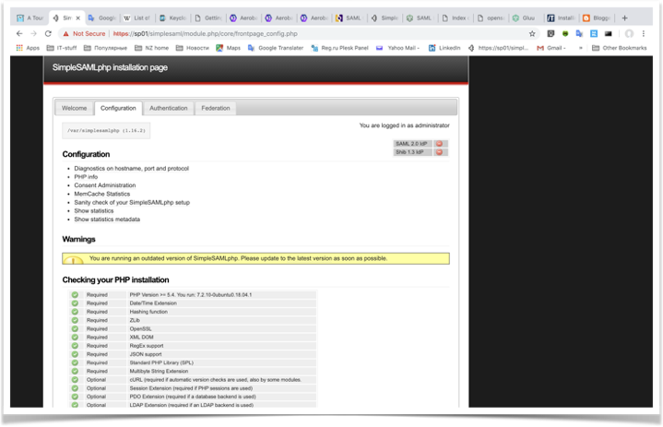
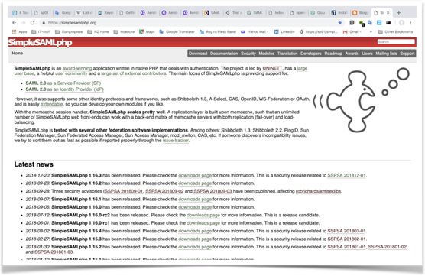
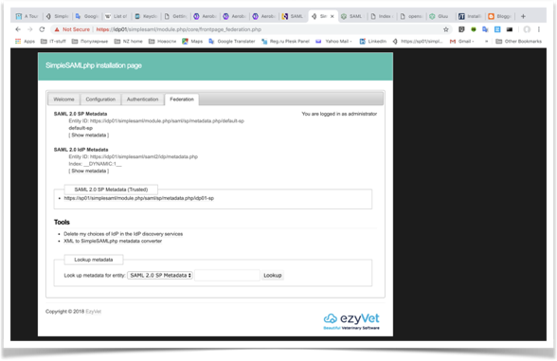
Development Stage - SimpleSAMLphp environment
Vagrant on the top of Oracle VirtualBox.
Ubuntu Linux inside.
The first Linux server configured as SimpleSAMLphp IDP server.
The second Linux server configured as SimpleSAMLphp SP.
Notes:
Firstly, I created a virtual environment for research, consisting of two nodes with the open source software SimpleSAMLphp. One node - IDP server, another - SP server.
I set they up to work with each other. After testing this configuration, we discussed the results and agreed that SimpleSAMLphp can be used as an API on the ezyVet application server side.
SimpleSAMLPhp was initially chosen to handle both the the service provider side (ezyVet) and the IDP. Since PHP is the predominant backend language of ezyVet. But the usability of SimpleSAMLPhp made it not a great choice to be the IDP, and since the IDP would be a completely separate system we could broaden our scope to other languages (and in the end using the very customisable prebuilt system we selected).
It was decided to return to the research stage for searching more suitable candidate for be IDP server.
This is a time to say about where SCRUM comes into scene.

Slide 13
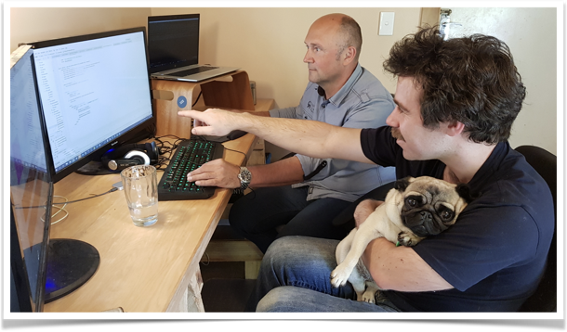
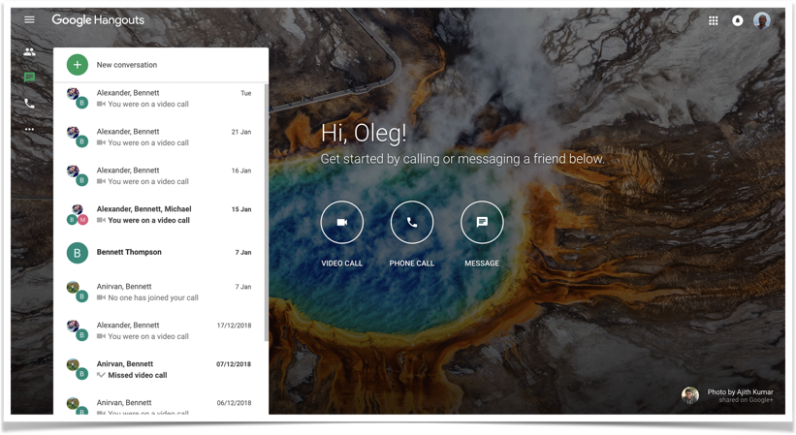
SCRUM
SCRUM sessions - Scrum Cycle had Hungouts with the team members from Auckland office.
Notes:
I have being participated in SCRUM.
We had morning HungOuts with the team members from Auckland office were we could discuss all aspects of the project.

Slide 14
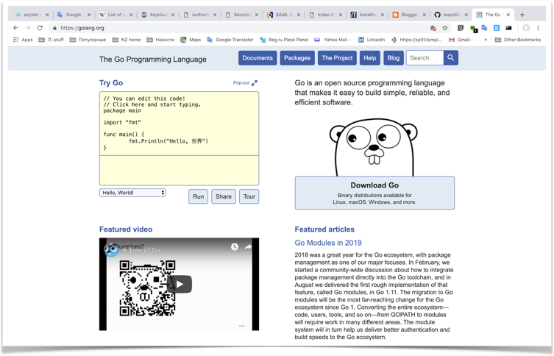
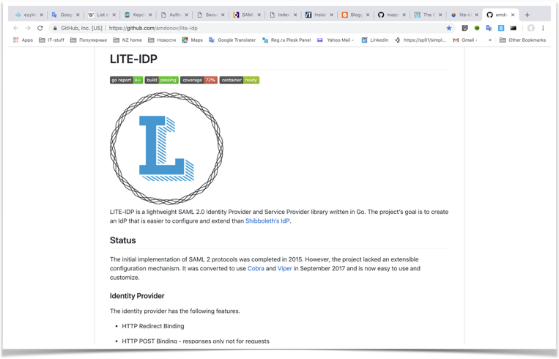
Searching right candidate for IDP server.
First candidate - LITE-IDP
LITE-IDP is a lightweight SAML 2.0 Identity Provider and Service Provider library written in Go. The project’s goal is to create an IdP that is easier to configure and extend than Shibboleth’s IdP.
Notes:
LITE-IDP is a lightweight SAML 2.0 Identity Provider and Service Provider library written in Go. The goal of the project is to create an IdP that is easier to configure and extend than a Shibboleth IdP. As a result, it appeared that the ease of this library is its weakness. In spite of the shown performance, we had to abandon it because of the low functionality and the obsolescence of some components that were no longer supported and developed. We switched to a new cycle of research.

Slide 15
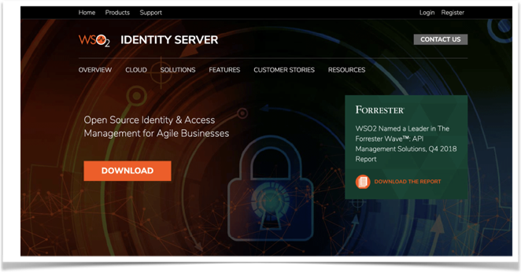
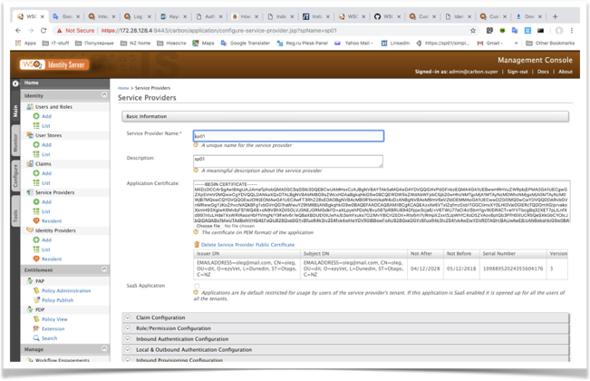
Searching right candidate for IDP server. New cycle.
Finally great candidate was find. It was WSO2 Identity Server - Open Source Project
Notes:
WSO2 Identity Server, a part of the WSO2 Integration Agile Platform, is a uniquely flexible, open source IAM product optimised for identity federation and SSO with comprehensive support for adaptive and strong authentication. It helps identity administrators to federate identities, secure access to web/mobile applications and endpoints, and bridge versatile identity protocols across on-prem and cloud environments.

Slide 16
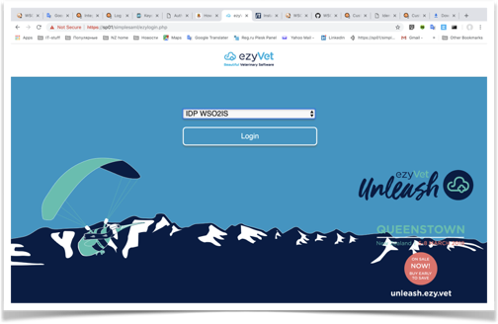
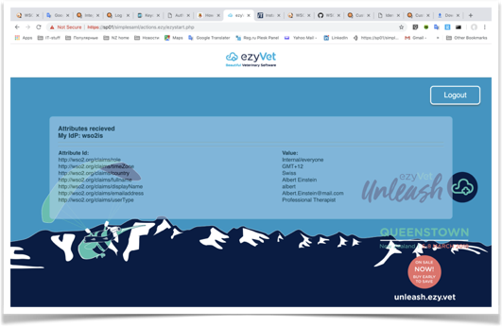
First results - New Cycle
Configuration proved to be workable
It showed great potential in further development and adaptation
Notes:
Configuration proved to be workable. That all consists of WSO2 Identity Provider server with MySql internal database for keeping user credentials and SimpleSAMLphp API library on the side of ezyVet application server. Login forms were redeveloped to have functionality which provides WSO2 IDP server and to have a ezyVet standard view .
This stage showed us great potential in further development.

Slide 17
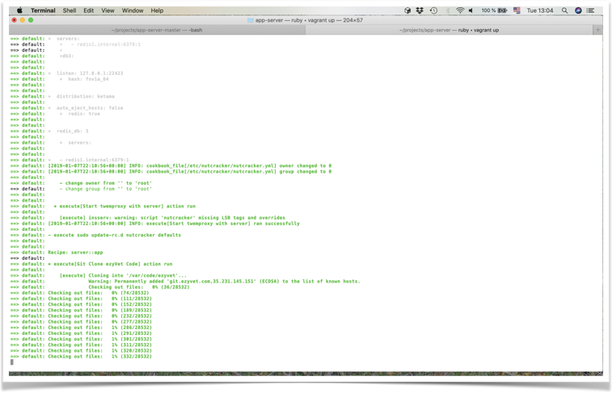
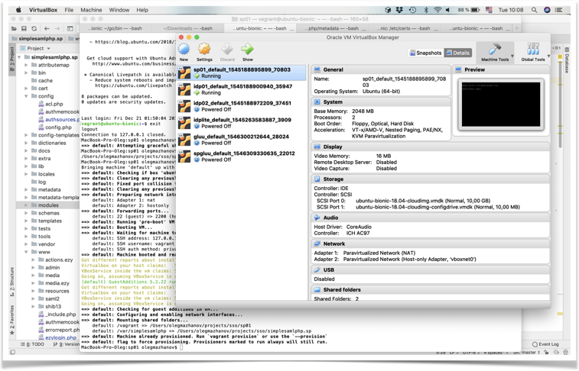
Stage - Developing automatic provisioning scripts
On this stage provisioning scripts for automatic - one-click installation where developed and pushed into GIT repository.
Notes:
On this stage provisioning scripts for automatic - one-click installation where developed and pushed into GIT repository.

Slide 18
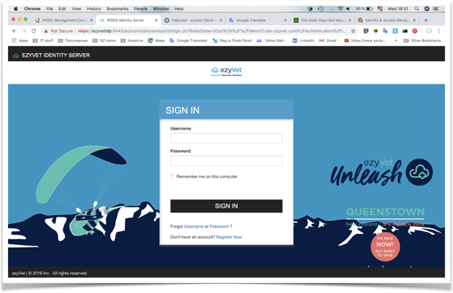
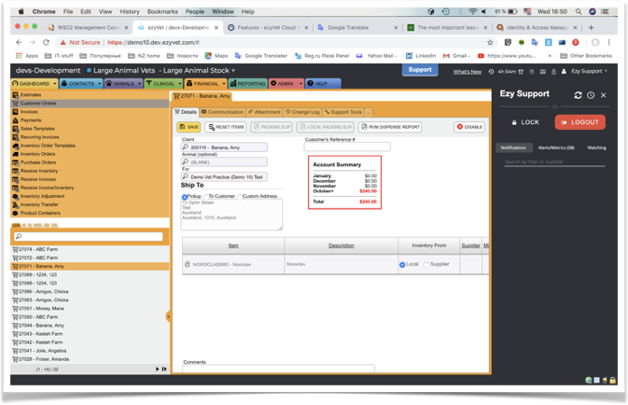
Best Time to Dive Deep
With some modifications in ezyVet application server been made by Bennett we have got working Identity System.
Notes:
With some modifications in ezyVet application server been made by Bennett we have got working Identity System. ( in drafts ). Now we can control user accounts and authentication process from WSO2 IDP sever console. But having so huge distributed system as ezyVet has means we need tools for automation procedures of creating, migrating user accounts and also creating Identity providers Servers themselves. We have run into new cycle of research and development.

Slide 19
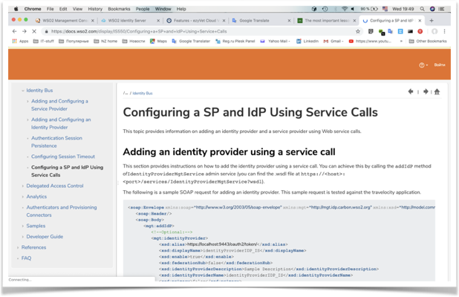
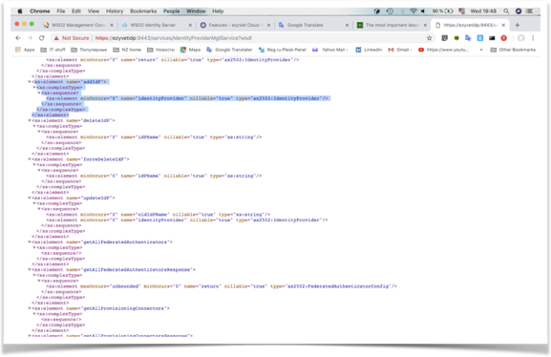
Stage - Researching Remote API
WSO2 project provides great remote API libraries interfaces.
Lot of things which have been made through WEB page interactively can be accomplished thought remote API calls.
This opens huge possibilities in automatisation all.
This great opportunity defenetly should be exploted in users migration process especially.
Notes:
WSO2 project provides great remote API libraries interfaces.
Lot of things which have been made through WEB page interactively can be accomplished thought remote API calls.
This opens huge possibilities in automatisation all.
This great opportunity defenetly should be exploted in users migration process especially.

Slide 20
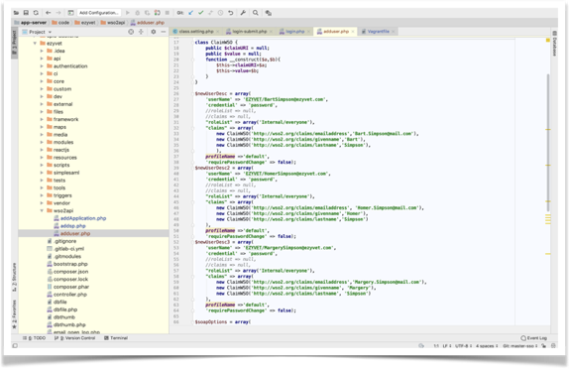
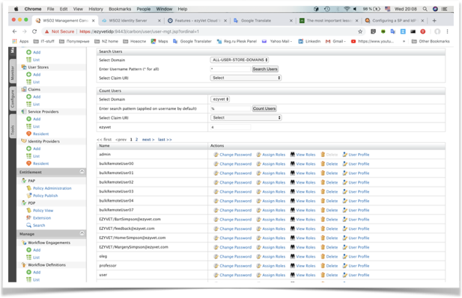
Stage - Tesing Remote API
Remote API calls work as described in documentation.
On this stage our feelings of moving in right direction significantly increased.
Notes:
Remote API calls work as described in documentation.
We have written some procedures which allow remote users creation, delation and etc.
Also we can create fully functional WSO2 Identity Provider Server by using remote API calls from ezyVet application server.
On this stage our feelings of moving in right direction significantly increased.

Slide 21

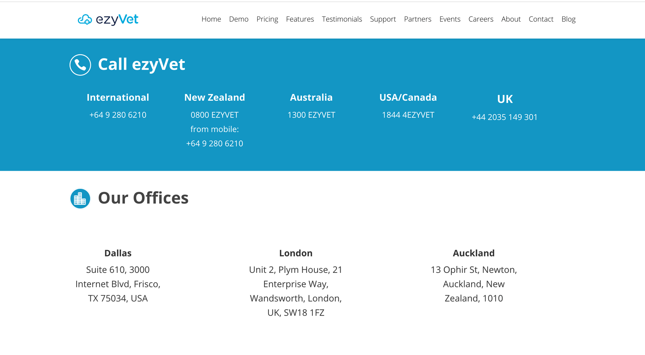



Thank you !
Notes:
The goals of the project was reached. The project can turn over into practice direction.
At the end I would like to thank for given me this great opportunity to participate in this project.

